Slide 1
Advance Electronic I
THIRD YEAR
Lecturer: Abbas S.
Hameed
Main References:
1- Robert L. Boylestad and Louis Nashelsky, “ Circuit Theory “.
Electronic
Devices and
2- Thomas L. Floyd, “ Electronic
Devices. CCV “.
3- Adel S. Sedra and Kenneth Carless Smith, “ Microelectronic circuits “.

Slide 2
Frequency Response
Electronic Devices and Circuit Theory 11th Ed., Robert L. Boylestad
For BJT and JFET
Lect 5 high freq. region
1- Electronic Devices and Circuit Theory by Robert L. Boylestad
2- Electronic Devices. CCV by Thomas L. Floyd
3- Microelectronic Circuits by Sedra/Smith

Slide 3
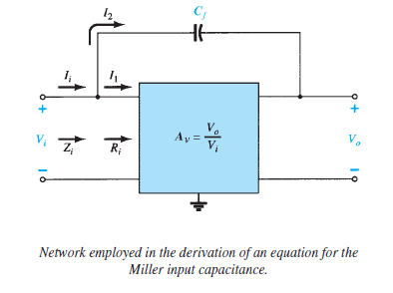
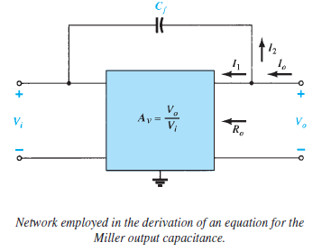
MILLER EFFECT CAPACITANCE

Slide 4
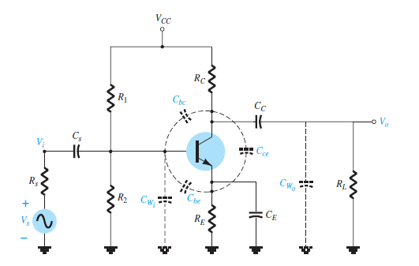
HIGH-FREQUENCY RESPONSE—BJT AMPLIFIER

Slide 5
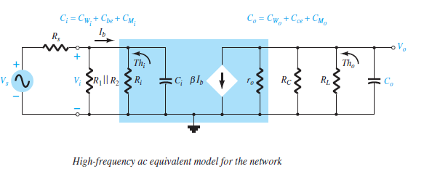
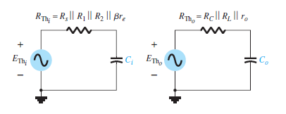

Slide 6
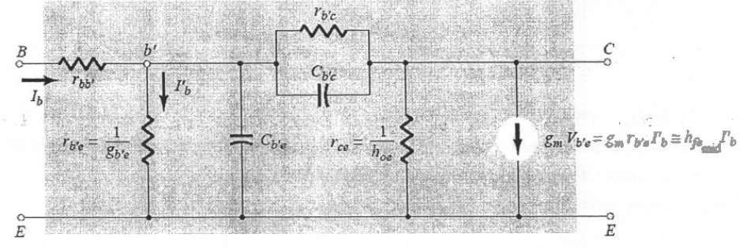
h fe (or B) Variation

Slide 7
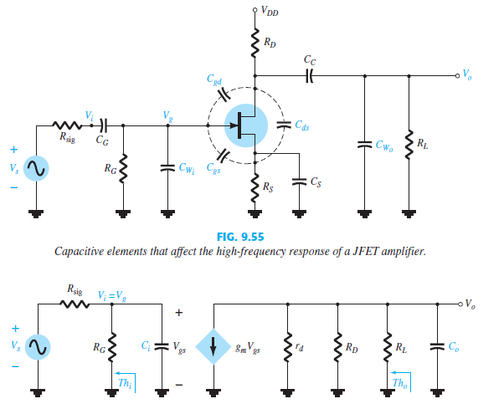
HIGH-FREQUENCY RESPONSE—FET

